Slide 1
Statistics & Bootstrapping
Part 2

Slide 2
Sampling With Replacement: When you sample with replacement, the object you selected is put back into the pool before another object is sampled.
Example:
vector <- 1:6
sample(vector, 3, replace = TRUE)
Output:

Slide 3
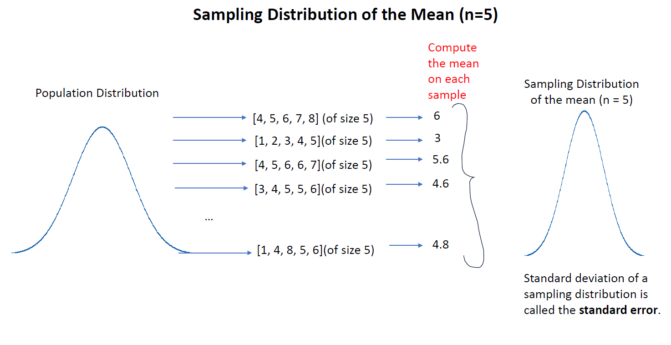
Standard Error: it's the standard deviation of a sampling distribution.

Slide 4
Review: Computing the Standard Error of a Sampling Distribution of the Mean with n = 100
Population
normal_pop <- rnorm(1000000, mean = 100, sd = 15)
Function
get_one_sample_mean <- function(i, population_vector, n) {
one_sample <- sample(population_vector, n)
one_sample_mean <- mean(one_sample)
return(one_sample_mean)
}

Slide 5
Sampling Distribution of the Mean with n = 100
sampling_distribution <- map_dbl(1:10000, get_one_sample_mean, population_vector= normal_pop, n = 100)
Standard Error
st_error <- sd(sampling_distribution)
st_error

Slide 6
Bootstrapping
The bootstrap is a resampling technique used to estimate standard errors and confidence intervals for sample statistics. It's particularly useful when you don't know the underlying data distribution.
A bootstrap sample is a sample of the same size of the original sample and sampling is done with replacement.

Slide 7
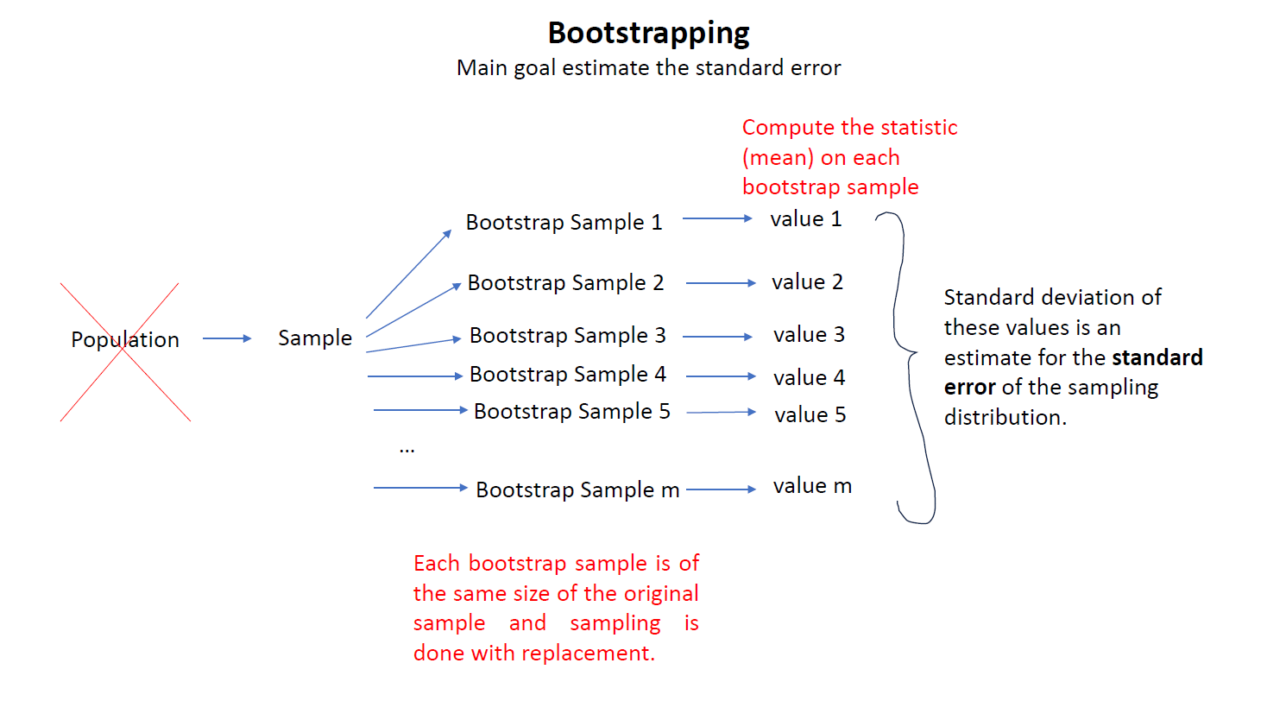

Slide 8
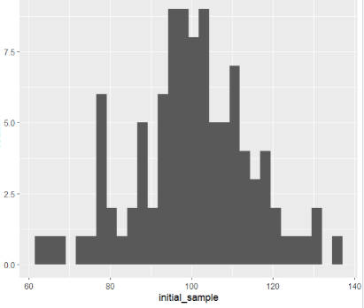
Step 1: Start with a sample.
initial_sample <- sample(normal_pop, 100)
Plot of the Initial Sample
sample_plot <- data.frame(initial_sample) %>%
ggplot(aes(x=initial_sample)) +
geom_histogram()
sample_plot

Slide 9
Step 2: Create a function that draws one bootstrap sample from a given sample and computes a statistic on the bootstrap sample. In this example the statistic is the mean.
boot_mean <- function(i, y){
boot_sample <- sample(y, length(y), replace = TRUE)
value <- mean(boot_sample)
return(value)
}

Slide 10
Step 3: Using the function from Step 2, draw 10000 bootstrap samples and compute the mean on each.
all_values <- map_dbl(1:10000, boot_mean, y = initial_sample)
Step 4: Compute the standard deviation of the 10000 bootstrap sample means from Step 3. That is the estimated standard error.
sd(all_values)
Output: 1.435214

